Slide 1


Ecotourism: Sustainable Travel for a Greener Future
Ecotourism is a sustainable approach to travel that emphasizes environmental conservation, cultural preservation, and community empowerment. By embracing ecotourism, travelers can explore the world's natural wonders while minimizing their impact and supporting local economies.
ABAY ANIL P
JEEVITH A.S

Slide 2



What is Ecotourism?
Responsible Travel
Environmental Stewardship
Ecotourism is a form of sustainable tourism that focuses on experiencing and appreciating natural environments and local cultures.
Ecotourism aims to have a low impact on the environment and support the well-being of local communities.
Educational Experience
Ecotourism provides opportunities for travelers to learn about and appreciate the natural and cultural heritage of the destinations they visit.

Slide 3

The Principles of Ecotourism
Minimize Impact
Promote Conservation
Empower Communities
Ecotourism seeks to minimize the negative environmental and social impacts of tourism activities.
Ecotourism supports the protection and management of natural areas and biodiversity.
Ecotourism aims to empower and benefit local communities, both economically and socially.

Slide 4


Environmental Conservation through Ecotourism
Habitat Protection
Wildlife Conservation
Ecotourism provides financial incentives to protect and preserve natural habitats and ecosystems.
Ecotourism supports the conservation of endangered species and their habitats.
1
2
3
Sustainable Resource Use
Ecotourism promotes the sustainable use of natural resources, such as water and energy.

Slide 5

Empowering Local Communities
1
Economic Benefits
2
Cultural Preservation
Ecotourism generates income and employment opportunities for local communities.
Ecotourism helps to preserve and celebrate the unique cultural traditions of host communities.
3
Capacity Building
Ecotourism provides opportunities for skill development and training within local communities.

Slide 6

Ecotourism Destinations: Global Hotspots
Amazon Rainforest
Galapagos Islands
Serengeti National Park
The Amazon basin, home to the world's largest tropical rainforest, offers unparalleled opportunities for ecotourism and wildlife viewing.
These remote islands in the Pacific Ocean are a prime destination for ecotourism, famous for their unique and diverse ecosystems.
The vast Serengeti plains in Tanzania are a prime example of ecotourism, allowing visitors to witness the annual wildebeest migration.

Slide 7


The Economic Benefits of Ecotourism
1
2
3
Job Creation
Revenue Generation
Investment in Conservation
Ecotourism generates employment opportunities in areas such as tour guiding, hospitality, and conservation.
Ecotourism provides a sustainable source of income for local communities and supports the growth of the tourism industry.
Ecotourism revenues can be reinvested into protecting natural areas and supporting environmental stewardship initiatives.

Slide 8


Ecotourism Challenges and Considerations
Overtourism
Environmental Impact
Cultural Preservation
Balancing the influx of visitors with the carrying capacity of fragile ecosystems is a key challenge.
Ensuring ecotourism activities have a minimal impact on the environment is crucial for long-term sustainability.
Protecting the cultural integrity of host communities and preventing exploitation is an important consideration.

Slide 9





Responsible Ecotourism Practices
Sustainable Travel
Mindful Exploration
Community Engagement
Choosing eco-friendly transportation options and minimizing waste during travel.
Respecting and appreciating the natural and cultural heritage of destinations.
Supporting local businesses and participating in community-based initiatives.

Slide 10
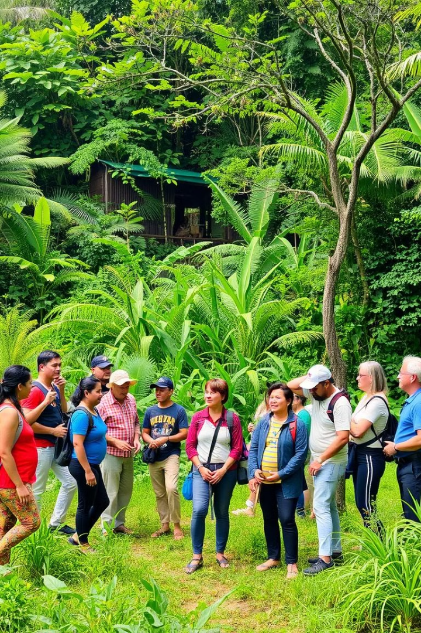



The Future of Ecotourism: Trends and Outlook
Technological Innovation
Advancements in technology can enhance the ecotourism experience and support sustainable practices.
Emerging Destinations
New ecotourism hotspots are expected to emerge, offering travelers unique and untouched natural experiences.
Increased Awareness
Growing public interest and concern for environmental issues will drive the demand for ecotourism.

